Slide 1
Plagiarism checker
Group : 14
Members : 1901008 - Abhishek Kumar
1901064- Divyansh Rajput
1901084 - Kamran Ayesh
1901096 - Kushagra Singh

Slide 2
Purpose
Help students analyze grammatical correctness of their
content(assignments, project , etc.).
Help teachers check and avoid plagiarism among student’s assignments.
Any guest user can check for grammatical errors and plagiarism in their documents.
A virtual classroom environment where teacher can post assignments and students can submit their assignments , teachers can then check for malpractices within submissions made by students.

Slide 3
Existing System : The present system has no integration of plagiarism checker, grammatical errors checker with student teacher portal and similar features for any guest user as well.
There are platforms for grammatical error checker but doesn’t have plagiarism checker.
Similarly there are platforms for plagiarism but doesn’t have grammatical checker.
Some platform provide virtual classroom facility but they don’t have plagiarism checker.
Also there is no such system which allows checking for plagiarism within assignments submitted by various students locally.

Slide 4
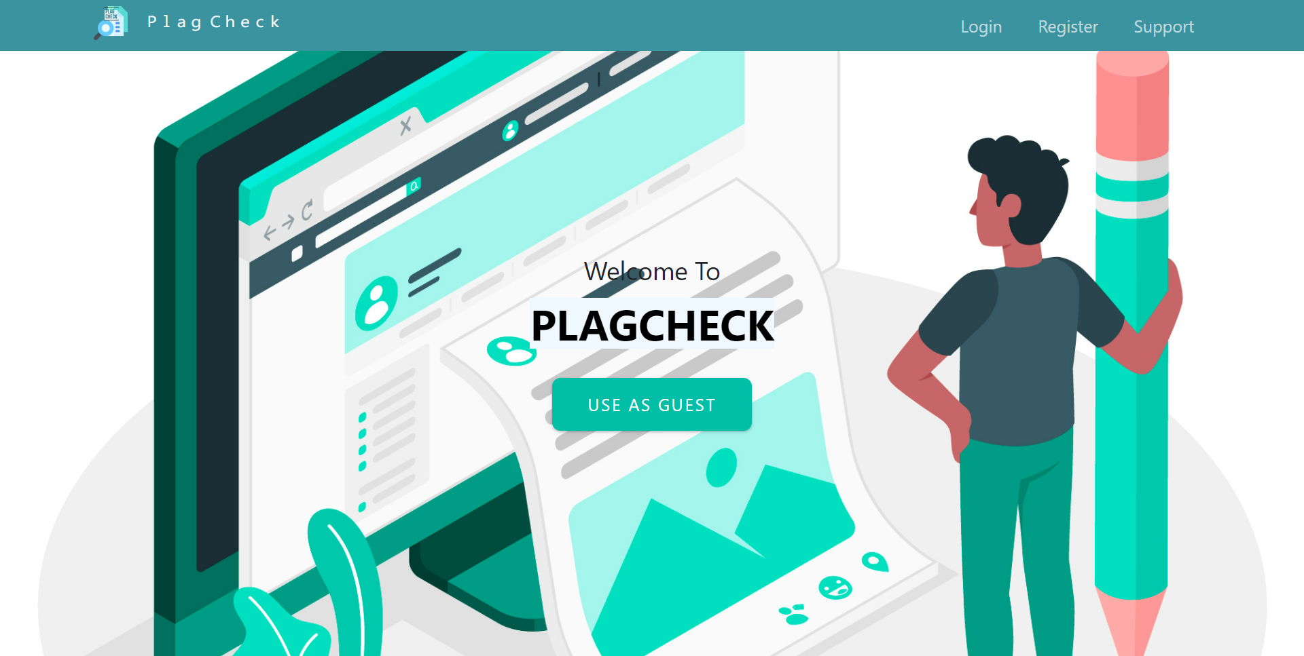
Proposed system : The plagiarism checker contains integrated grammatical error checker and a teacher-student portal.
Homepage :

Slide 5
Components :
Student/Teacher registration form
Student/Teacher login form

Slide 6
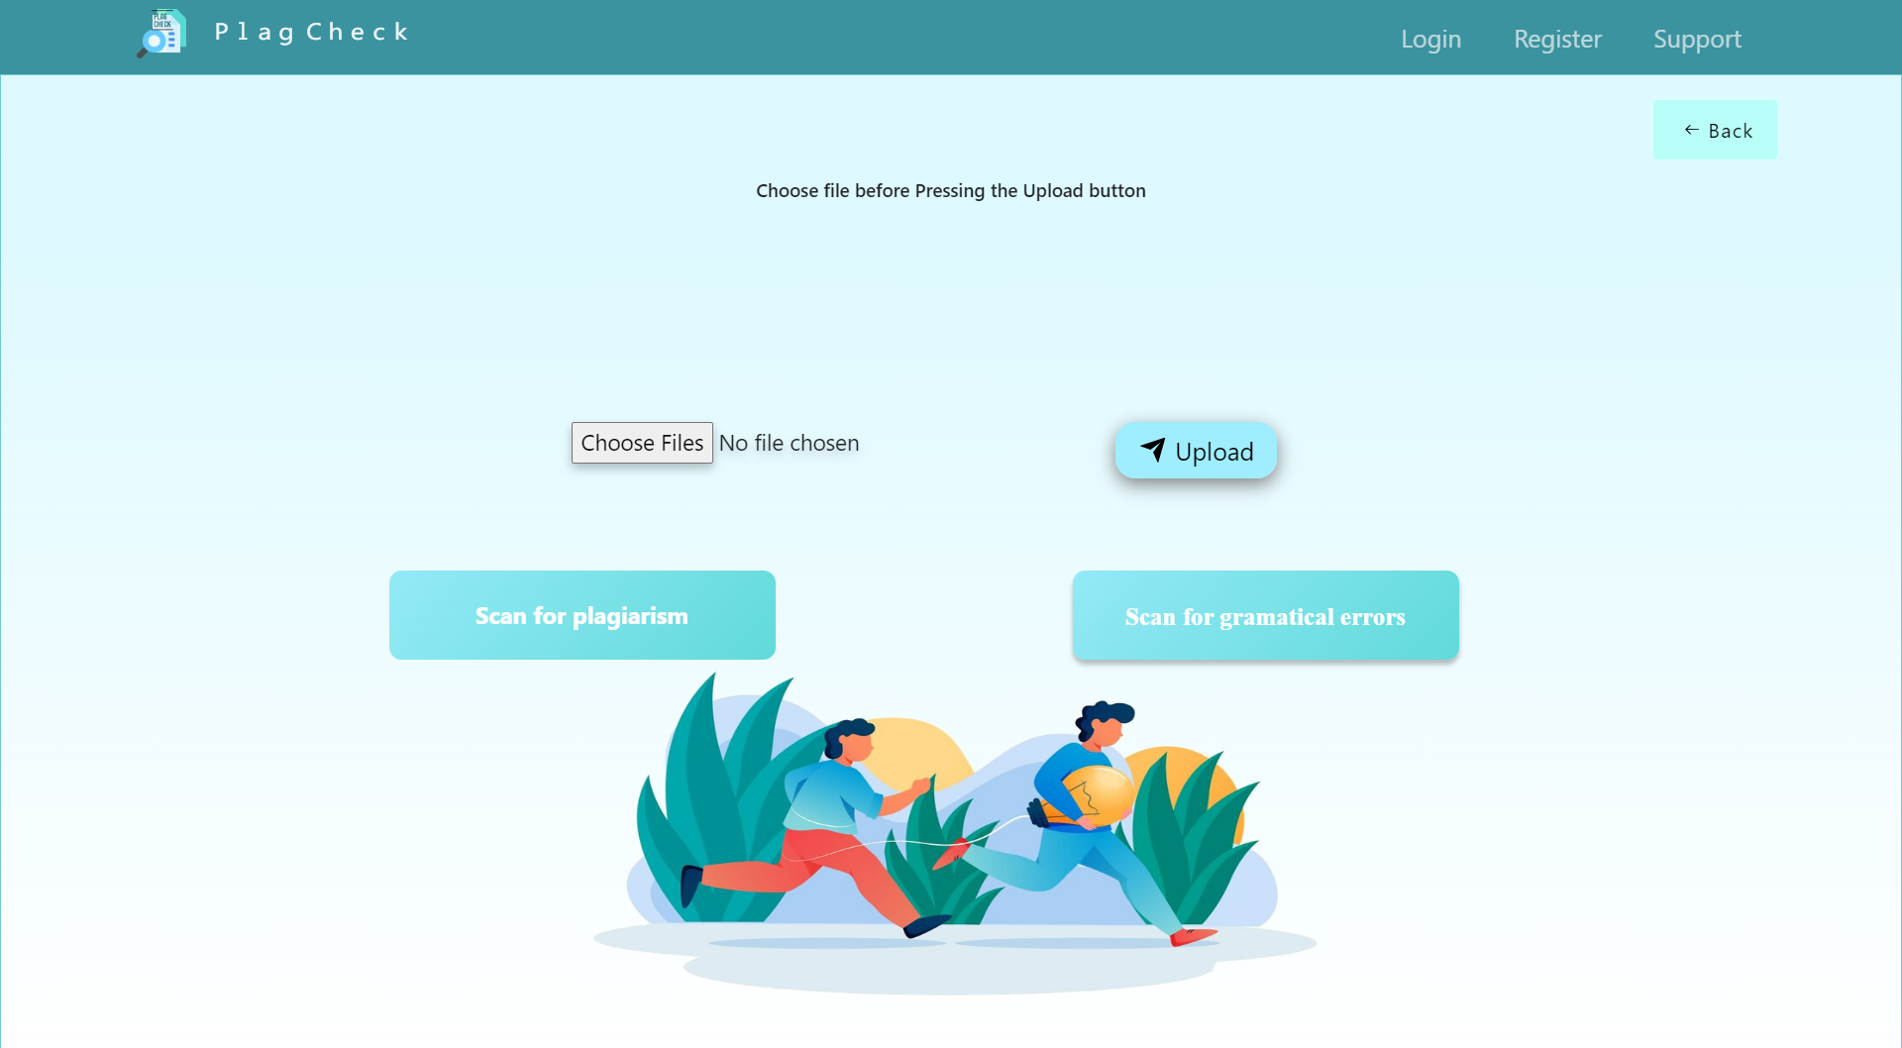
Guest Page: Guest can upload file/s and can check plagiarism and grammatical error in his/her file.

Slide 7
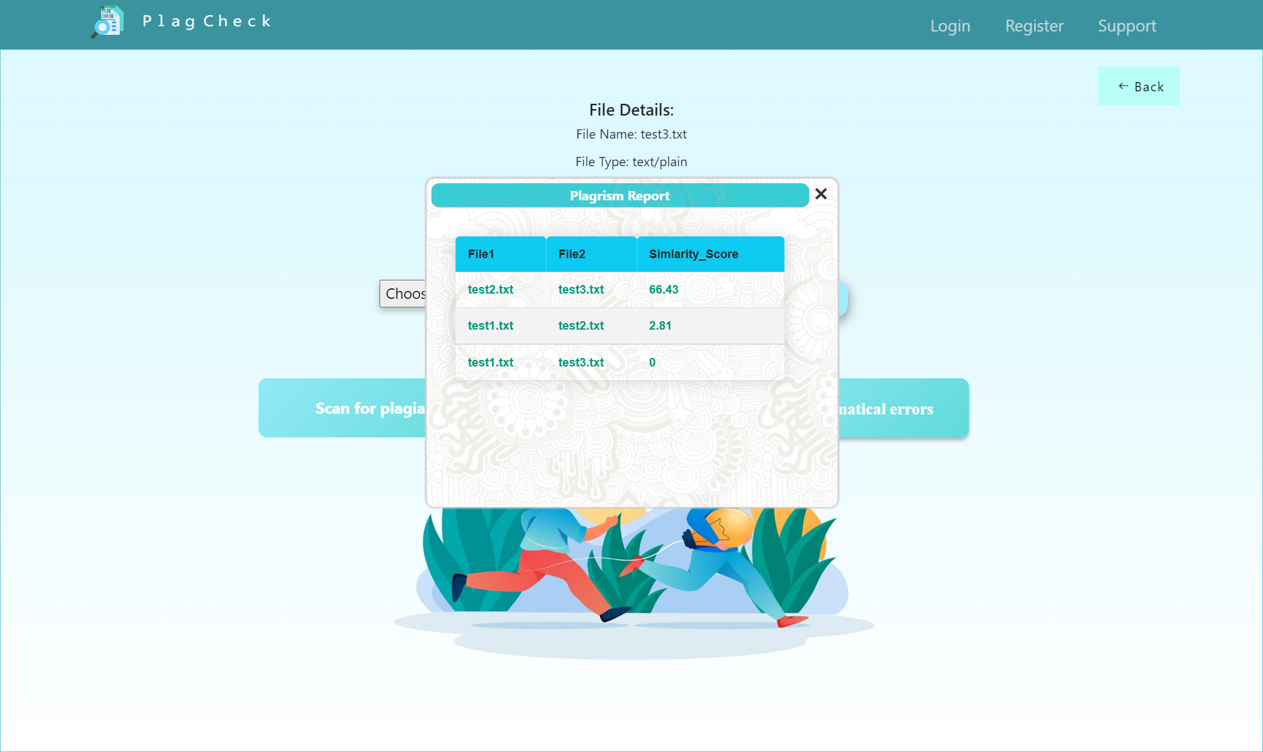
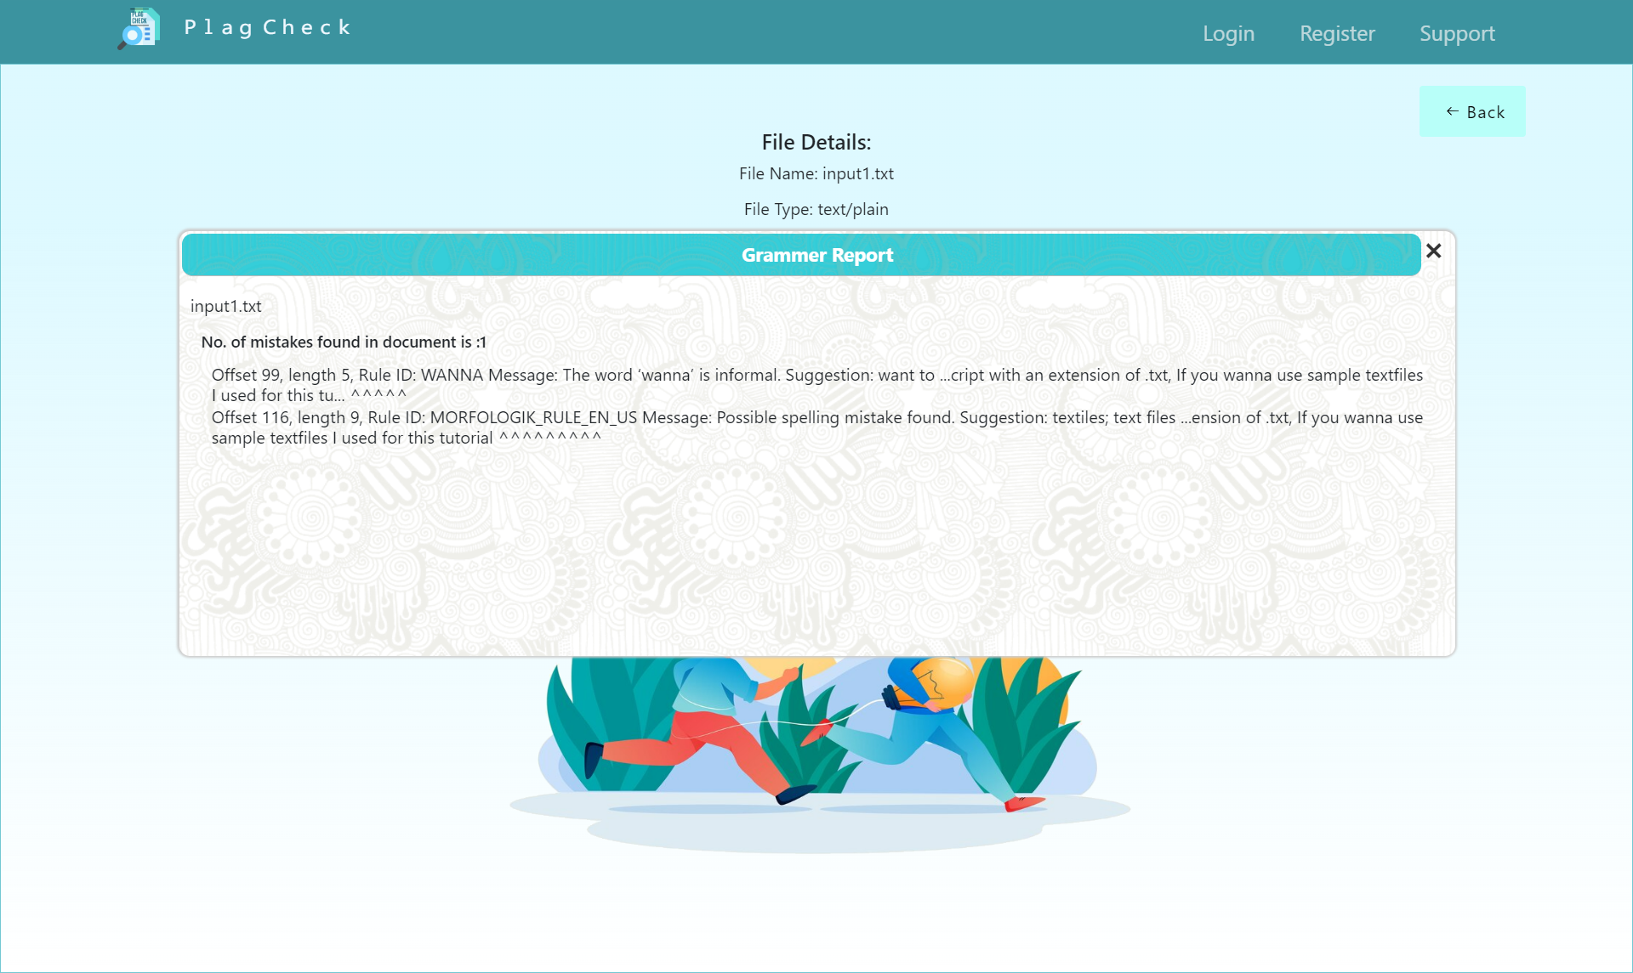
Results : Plagiarism and grammatical report.
Plagiarism Report
Grammatical Error Report

Slide 8
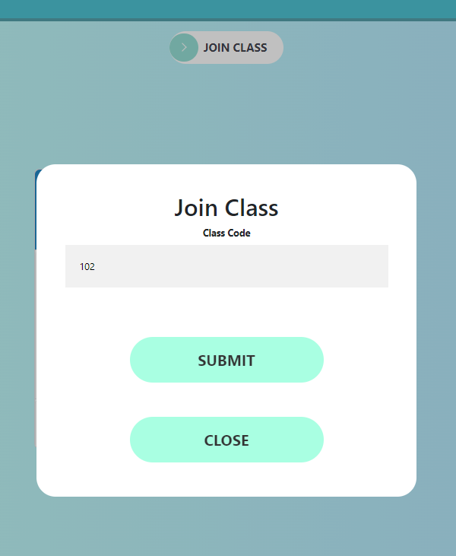
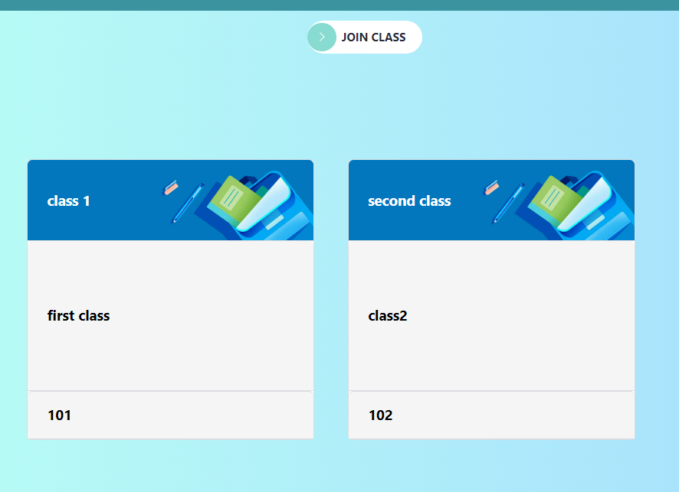
Student pages : Join class
Student can join class using class code.
Student may choose their class using its respective class code/name.

Slide 9
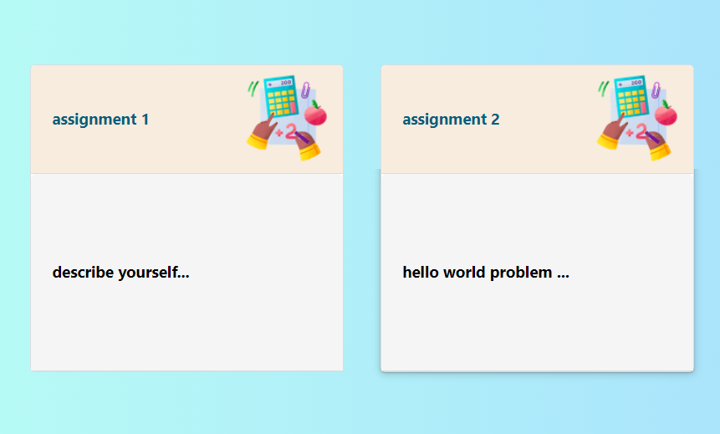
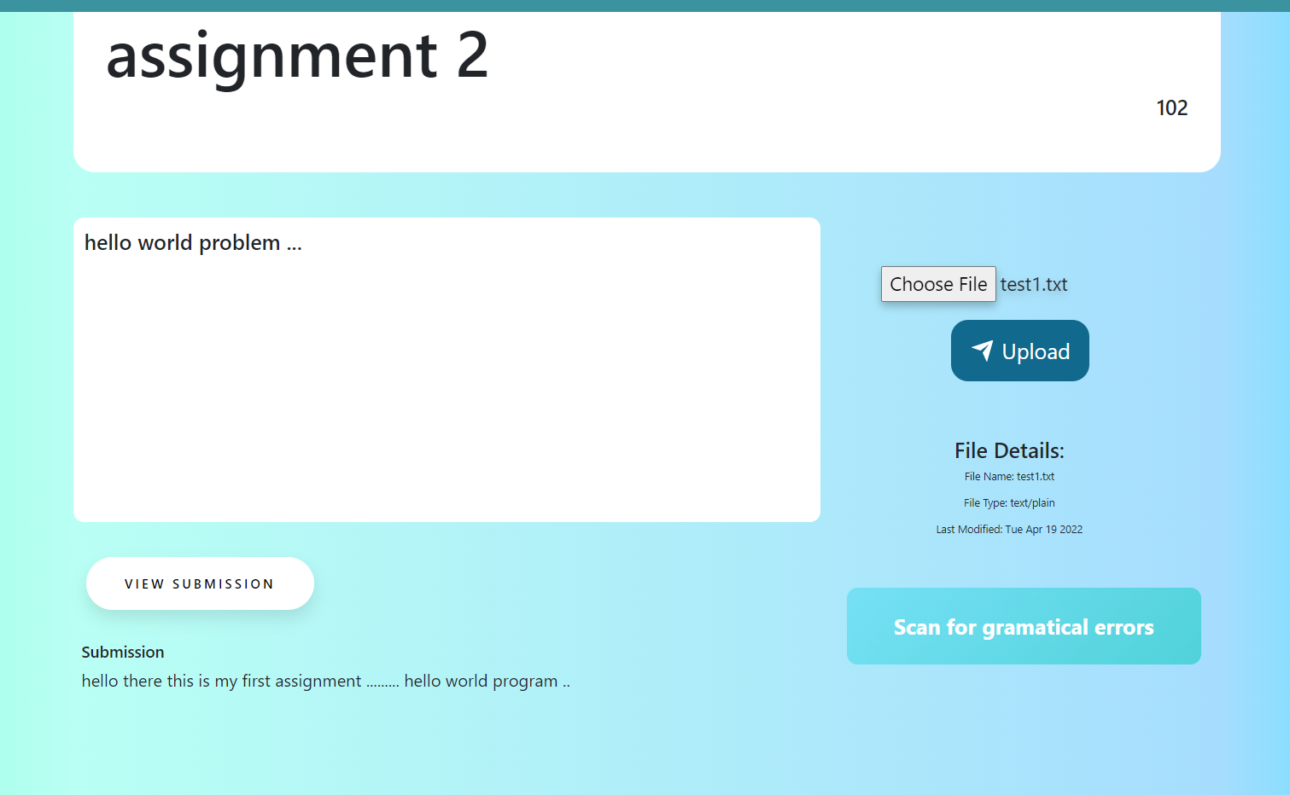
Student Pages : Submit assignment and view grammatical report.
Students can view their assignments .
Students can view their submissions and check for grammatical errors.

Slide 10
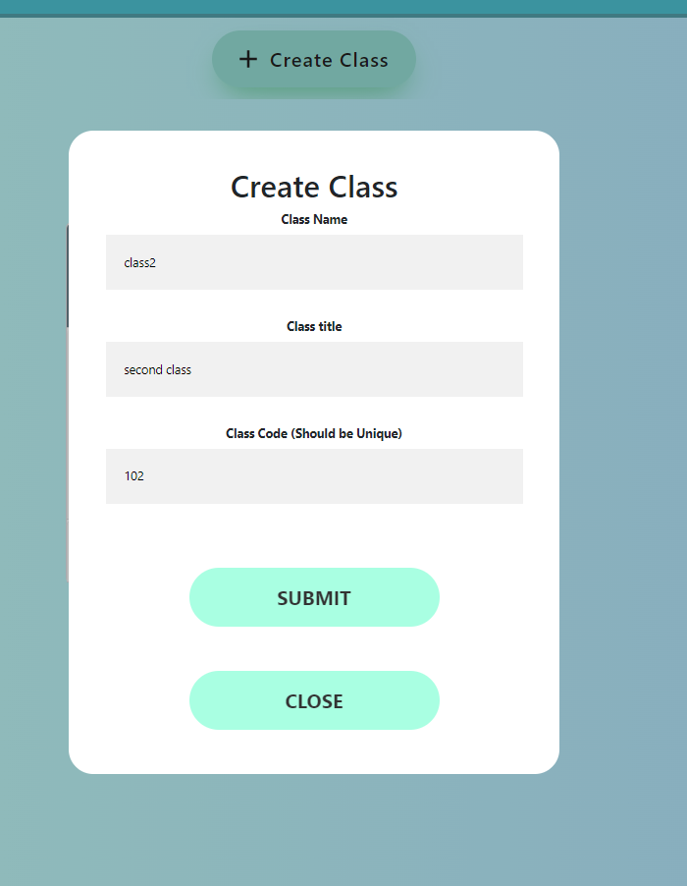
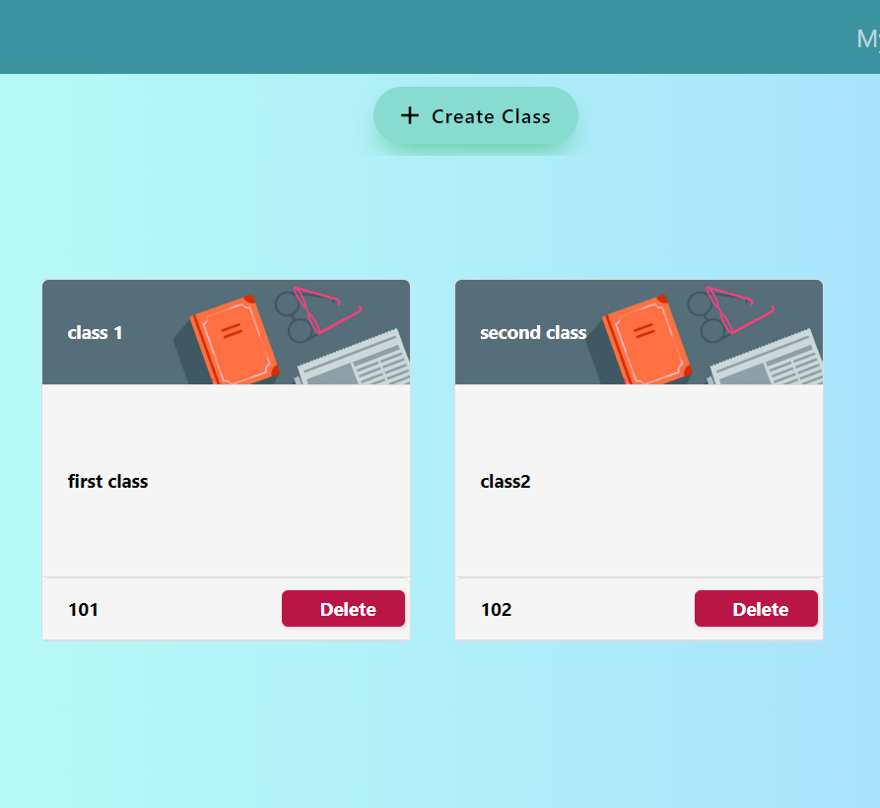
Teacher pages : Class
Teacher can create new class with a class title and unique class code.
Teacher can also delete any of the classes created.

Slide 11
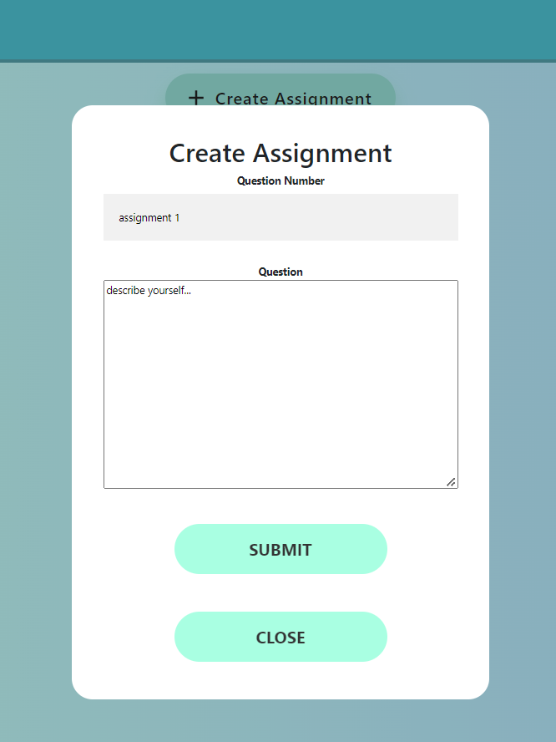
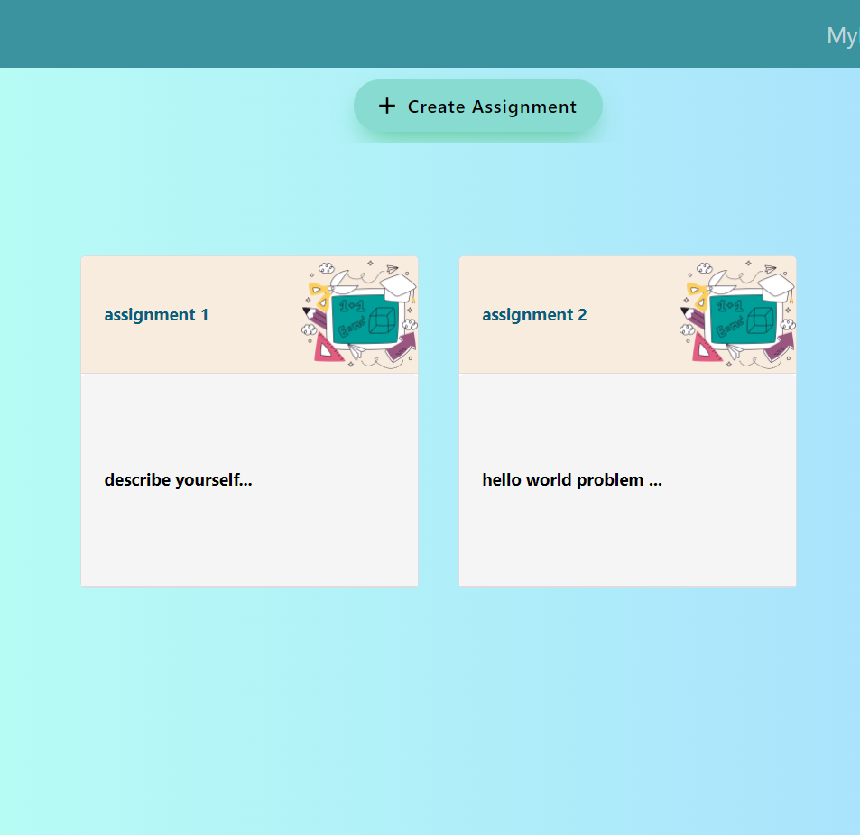
Teacher Pages : Assignment
Teacher can create new assignment.
Teacher can view his/her assignment
given.

Slide 12
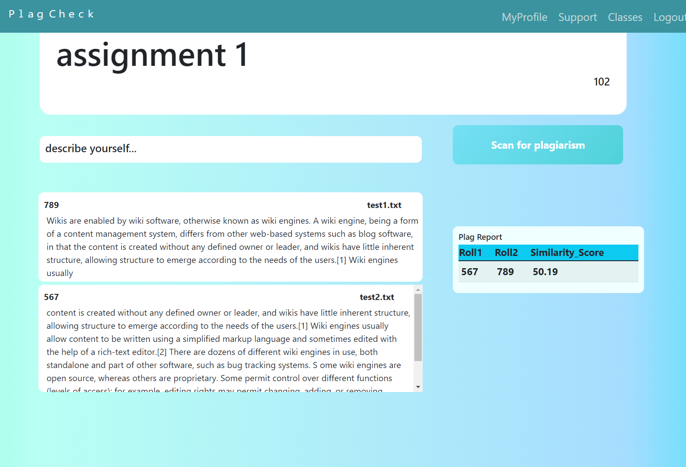
Teacher Pages : Report
Teacher can view the submitted assignments and can view similarity score using plagiarism report.

Slide 13





Technologies Used :

Slide 14
Contributions:
Abhishek: Frontend
Divyansh : Frontend
Kamran : Backend
Kushagra: Frontend and Backend

